Slide 1
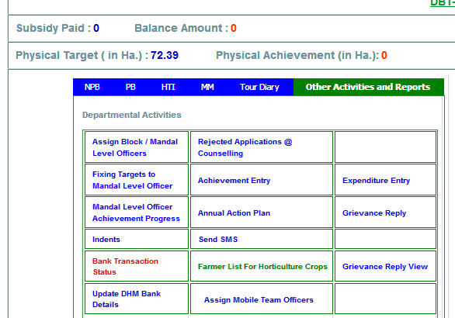
1. Open ADH Login
2. Click on Other Activities and Reports
3. Click on Fixing Targets to Mandal Level Officer

Slide 2
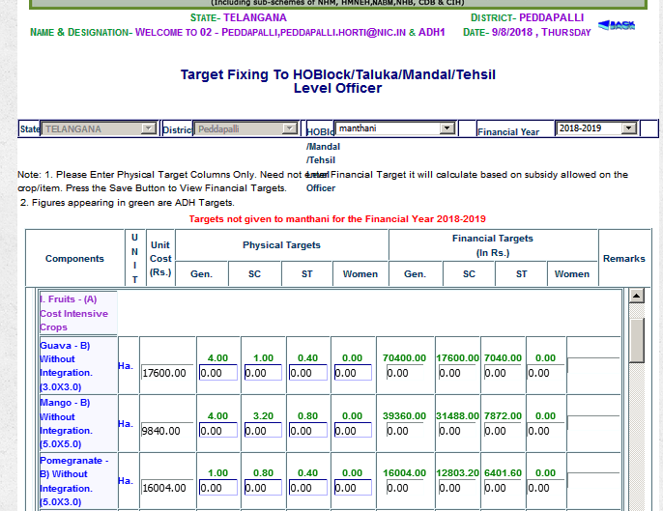
4. Select HQ of Mandal Level Officer
5. Enter the Physical Target (Gen, SC & ST) only (Women not applicable to Telangana)
No need to update Financial Target, It will calculated automatically once click to Save Button

Slide 3
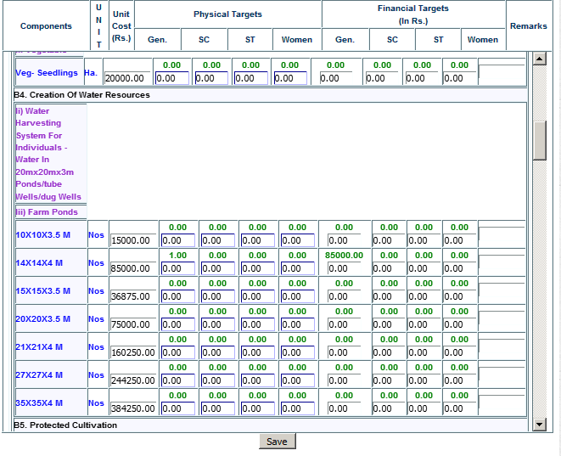
6. Click to SAVE Button
7. Same process will be replicate to fix other HOs Target

